Slide 1



Noida Institute of Engineering and Technology, Greater Noida
Concurrency and Deadlock Management
Unit: 3
Operating Systems (BCSE0303)
Atul Garg
Assistant Professor
IT Department
Course Details (B Tech IIIrd Sem)

Slide 2
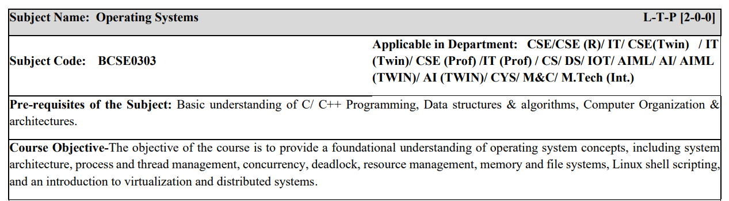
Syllabus Of Course
CO 1 | Understand operating systems architecture and types, and use the Linux CLI for basic Operations | K2
CO2 | Implement the CPU scheduling algorithms along with uses of multithreading models | K4
CO3 | Implement concurrency control, process synchronization techniques, and deadlock handling methods | K4
CO4 | Implement memory management strategies and page repla cement algorithms to optimize system performance | K4
CO5 | Analyze file systems and configure distributed systems and virtual machines in modern operating systems. | K4

Slide 3
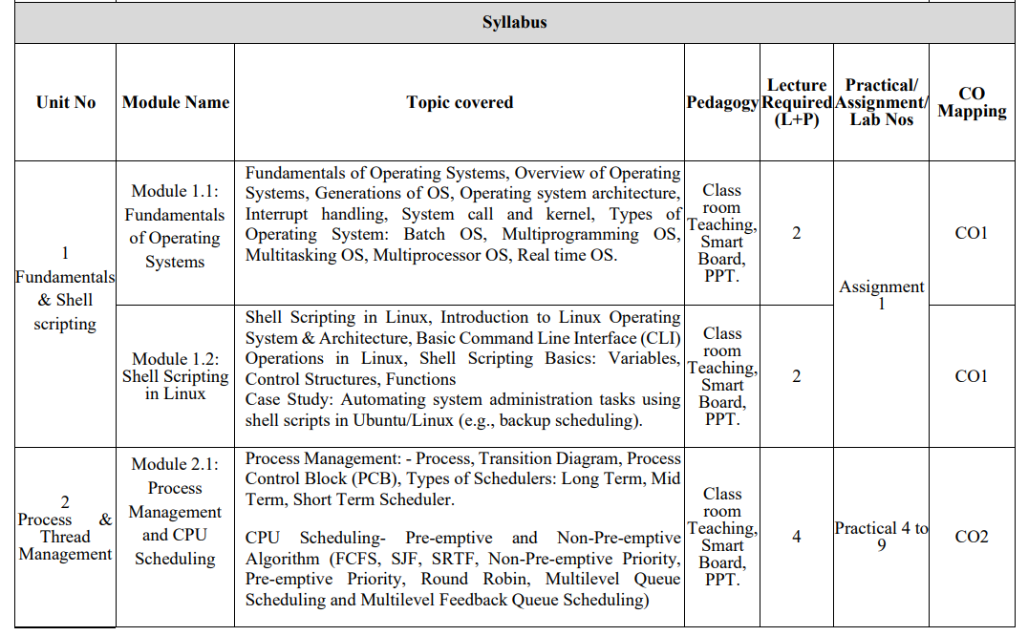
Syllabus Of Course

Slide 4
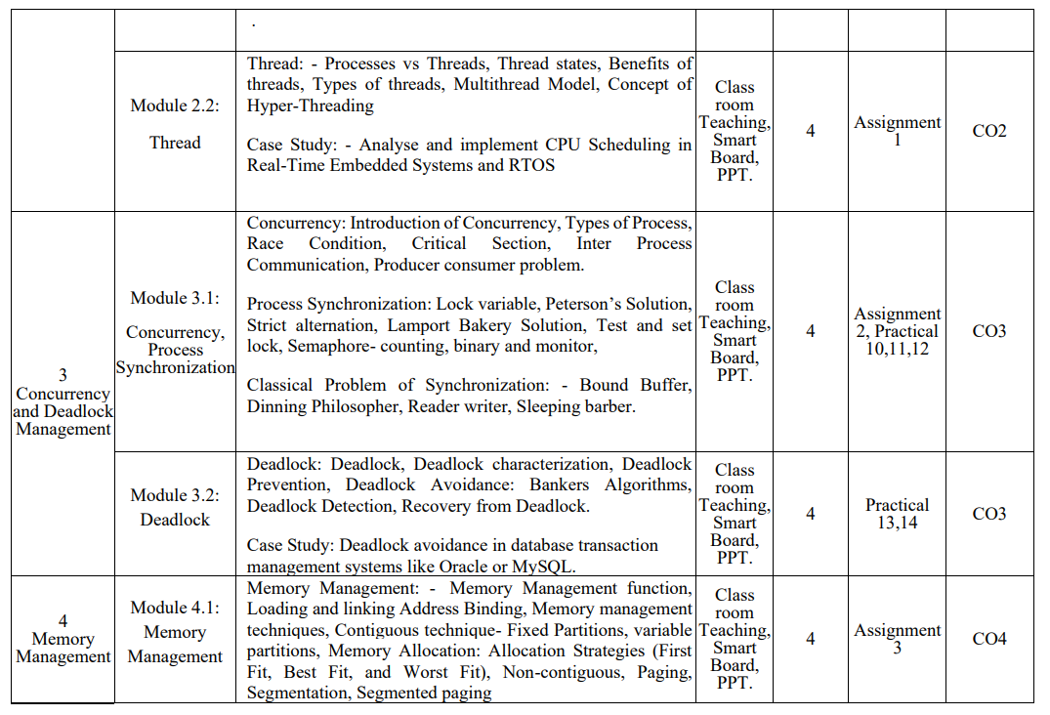
Syllabus Of Course

Slide 5
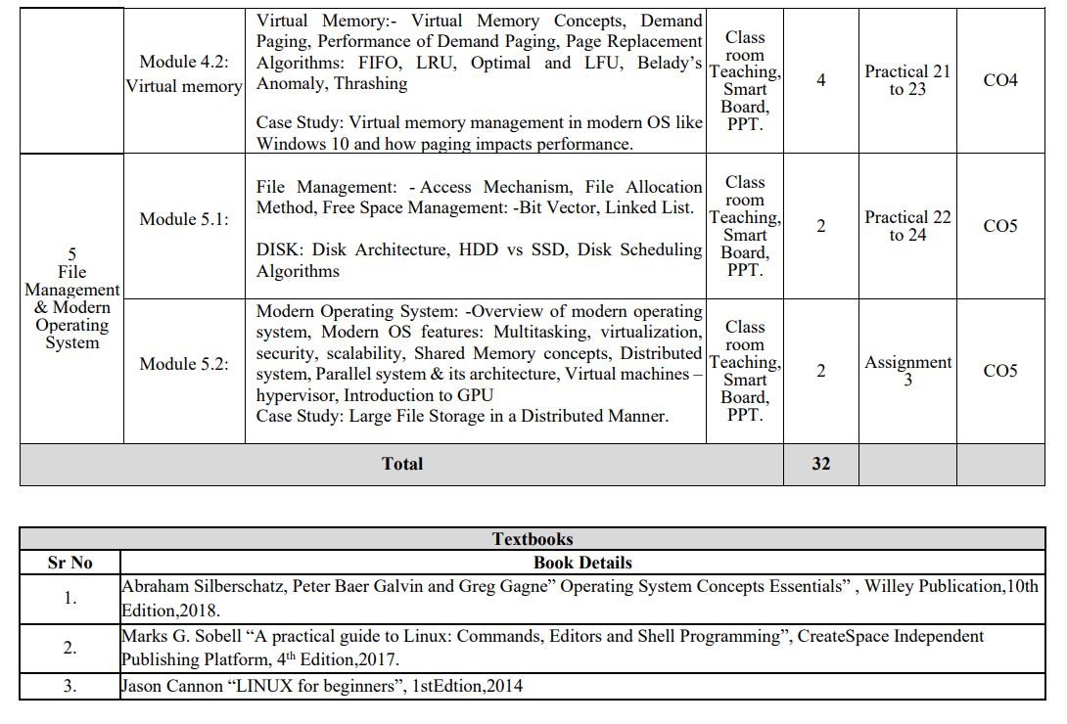
Subject Syllabus

Slide 6
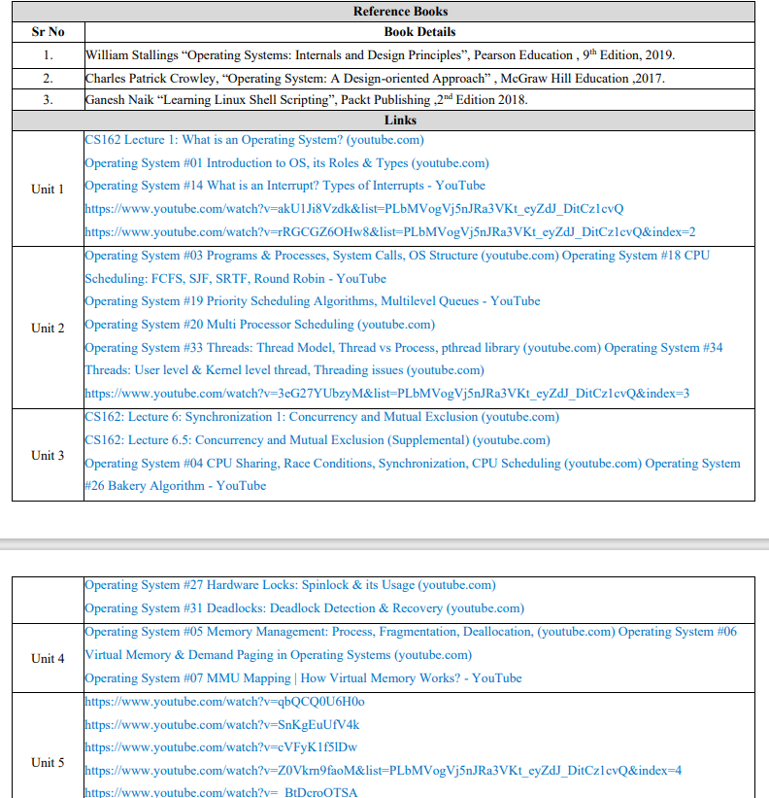
Subject Syllabus

Slide 7
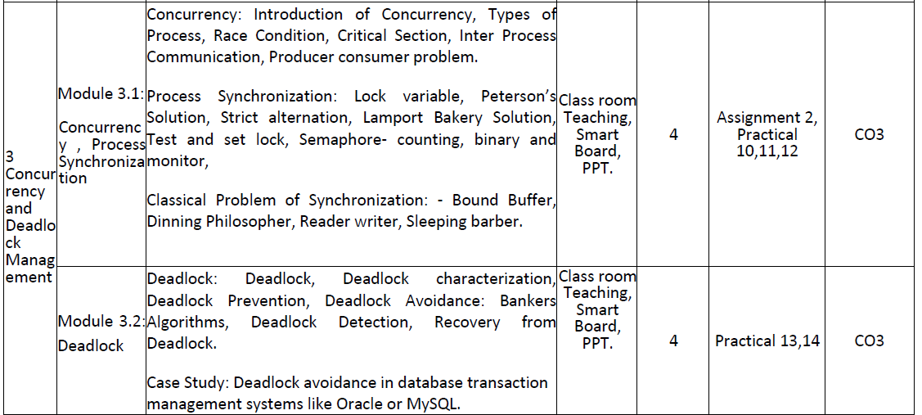
UNIT Content

Slide 8
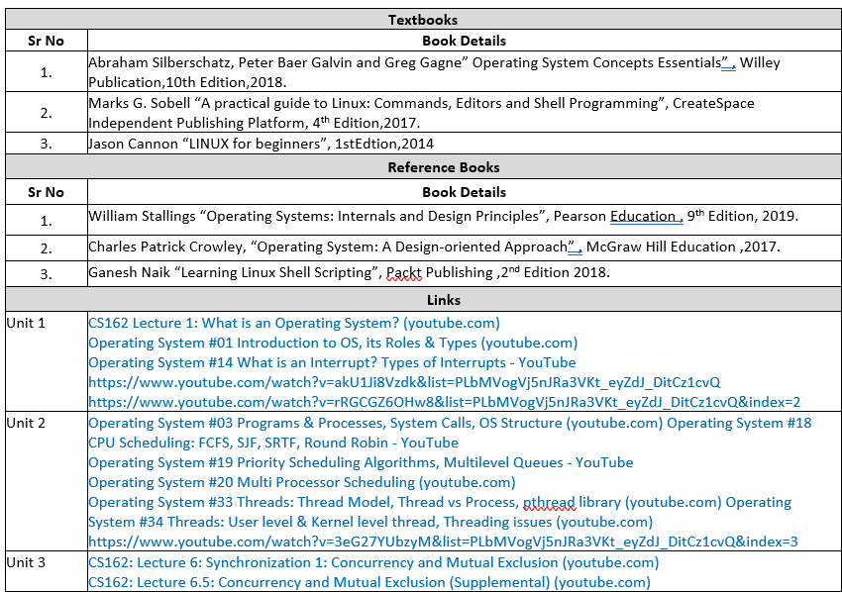
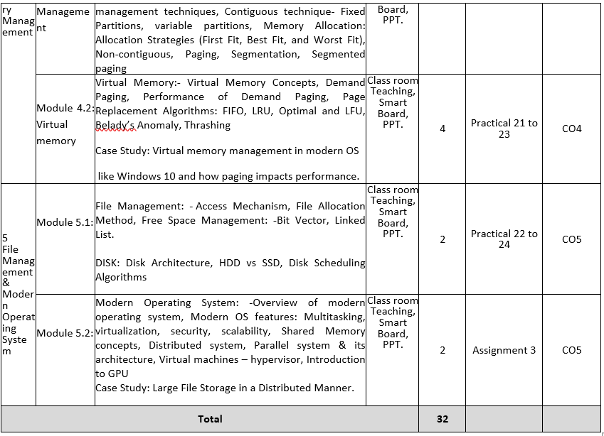
Subject Syllabus

Slide 9
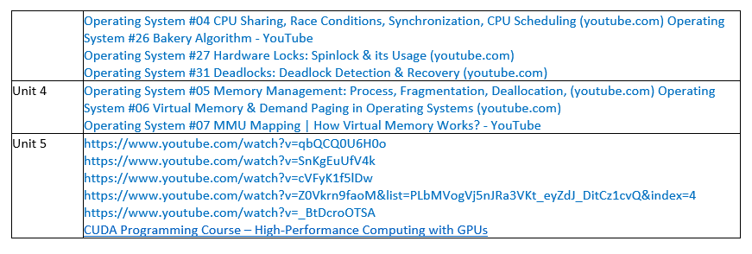
Subject Syllabus

Slide 10

Branch wise Applications
Airlines reservation system.
Air traffic control system.
Systems that provide immediate updating.
Used in any system that provides up to date and minute
information on stock prices.
Defense application systems like RADAR.
Networked Multimedia Systems.
Command Control Systems.

Slide 11
Course Objectives
To learn the fundamentals of Operating Systems.
To understand what a process is and how processes are synchronized and scheduled.
To understand different approaches to memory management.
Students should be able to use system calls for managing processes, memory and the file system.
To understand the structure and organization of the file system.

Slide 12
Course Outcome
At the end of semester, students will be able to:

Slide 13
Program Outcomes

Slide 14

COs and POs Mapping
Sr. No | Course Outcome | PO1 | PO2 | PO3 | PO4 | PO5 | PO6 | PO7 | PO8 | PO9 | PO10 | PO11
1 | .1 | 3 | 2 | 2 | 1 | 2 | - | - | - | - | 1 | 1
2 | .2 | 3 | 3 | 3 | 2 | 2 | - | - | - | - | 1 | 1
3 | .3 | 3 | 3 | 3 | 2 | 2 | - | - | - | - | 1 | 1
4 | .4 | 3 | 3 | 3 | 2 | 2 | - | - | - | - | 1 | 1
5 | .5 | 3 | 2 | 3 | 2 | 2 | - | - | - | - | 1 | 2
6 | Average | 3 | 2.6 | 2.8 | 1.8 | 2 | - | - | - | - | 1 | 1.2

Slide 15
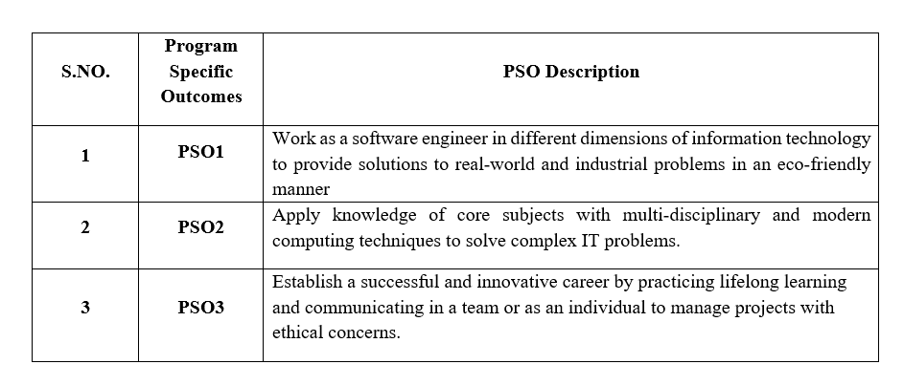
Program Specific Outcomes

Slide 16
COs and PSOs Mapping
Course Outcomes | Program Specific Outcomes
 | PSO1 | PSO2 | PSO3
BCSE0303A.1 | 2 | 1 | 2
BCSE0303A.2 | 2 | 2 | 1
BCSE0303A.3 | 2 | 3 | 3
BCSE0303A.4 | 2 | 2 | 1
BCSE0303A.5 | 2 | 2 | 2

Slide 17

Program Educational Objectives (PEOs)
The graduates will be:
PEO1:To apply sound knowledge combining technical expertise, and problem-solving skills to fulfill the needs of the IT industry and stay updated with the latest emerging trends.
PEO2:To provide sustainable solutions for real-life problems by designing innovative and interdisciplinary systems using the latest digital technologies for serving academia, industry, and society.
PEO3:To reflect professional attitude, social ethics, communication, teamwork, and leadership skills in research and product development to face global challenges.
PEO4:To pursue higher studies and develop their career successfully in the software industry and R&D sectors with a lifelong learning frame of mind.

Slide 18

Brief Introduction about the subject with video
A process in an operating system (OS) is essentially a program in execution. It represents the basic unit of work that the OS manages. When a program is loaded into memory and begins execution, it becomes a process. This transformation from a passive entity (program) to an active entity (process) is fundamental to how operating systems functions
YouTube/other Video Links
https://www.bing.com/videos/riverview/relatedvideo?&q
https://www.bing.com/videos/riverview/relatedvideo?&q

Slide 19
Unit-2 Content
Concurrency: Race condition, critical section, Inter process communication
Classical problems of synchronization:
Producer consumer problem
Dining philosopher’s problem
Readers writers problem
Sleeping barber problem
Process Synchronization: Lock variable’s, Peterson’s solution, strict alternation, Lamport Bakery solution, test and set lock, semaphore
Deadlock: Deadlock characterization, prevention, Avoidance, Banker’s Algorithm, Deadlock detection, Recovery from deadlock

Slide 20
Prerequisite and Recap
Familiarity from the operating system definition and characteristics
Familiarity from operating system functions
Process management and scheduling
Different types of schedulers etc.

Slide 21
Contents
Concurrency: Race condition, critical section, Inter process communication
Classical problems of synchronization:
Producer consumer problem
Dining philosopher’s problem
Readers writers problem
Sleeping barber problem
Process Synchronization: Lock variable’s, Peterson’s solution, strict alternation, Lamport Bakery solution, test and set lock, semaphore
Deadlock: Deadlock characterization, prevention, Avoidance, Banker’s Algorithm, Deadlock detection, Recovery from deadlock

Slide 22
Branch wise Applications
Web Servers → handling thousands of requests at once
Banking system → Two ATMs withdrawing from the same account.
Mutex Locks
Application 1: File access → Only one process edits a file at a time.
Application 2: Bank account → Prevents two ATMs from updating balance simultaneously.
Semaphores
Application 1: Traffic signals → Semaphore values manage cars at intersections.
Application 2: Operating system scheduling → Controls access to limited resources like CPU or printers.

Slide 23
Branch wise Applications
Resource Deadlock
Application 1: Printer + Scanner → One process holds printer and waits for scanner, another holds scanner and waits for printer.
Application 2: Database system → Transaction 1 locks Table A and waits for Table B, while Transaction 2 locks Table B and waits for Table A.🔹 2.
Communication Deadlock
Application 1: Client–Server → Client waits for server response, server waits for client request (neither proceeds).Application 2: Message passing system → Two processes wait for messages from each other (circular wait).

Slide 24
Topic Objectives
Topic | Objective
 | Students will be able to
Concurrency | Understand the How multiple processes or threads can run independently and simultaneously.
Classical problems of synchronization | Helping students apply concurrency concepts to real-world scenarios.
Process Synchronization | Students will learn how to coordinate multiple processes to safely access shared resources without causing data inconsistency or conflicts.
Deadlock | Students will learn how to identify, prevent, avoid, detect, and recover from deadlocks in systems where multiple processes compete for limited shared resources.
9/1/2025
Ms. Rashmi Bhardwaj OS Unit Number:1
24

Slide 25
Concurrency
Definition
Concurrency in OS means executing multiple processes or threads in overlapping time periods.
OS manages resources to ensure fairness, efficiency, and correctness.
It does not require simultaneous execution — interleaving is enough.
OS Role in Concurrency
Process Scheduling – decides which process runs next.
Resource Allocation – manages CPU, memory, I/O.
Synchronization – coordinates access to shared data.
Deadlock Handling – prevents or resolves resource waits.
9/1/2025
25

Slide 26
Concurrency
Types of Concurrency in OS
Process-Level Concurrency – multiple independent processes.
Thread-Level Concurrency – threads within a process.
Distributed Concurrency – processes across networked systems.
Challenges in OS Concurrency
Race Conditions – incorrect results due to interleaving.
Deadlocks – processes wait forever for resources.
Starvation – some processes never get CPU time.
Synchronization Overhead – too much locking slows performance.
9/1/2025
26

Slide 27
Race Condition
Definition
A race condition occurs when multiple processes or threads access and manipulate shared data concurrently,and the final result depends on the timing or order of execution.
How It Happens (as in the image)
Two threads (or processes) try to update the same variable in shared memory.
Thread 1 reads the value → modifies it → writes it back.
Thread 2 reads the value → modifies it → writes it back.
If both read the old value before either writes, one update gets lost.
Example
Shared variable X = 5 Thread 1: Reads 5 → adds 1 → writes 6.
Thread 2: Reads 5 → adds 2 → writes 7.
Expected: X = 8
Actual: X = 6 or X = 7 (update lost).
9/1/2025
27

Slide 28
Race Condition
Effects
Incorrect results (data corruption).
Unpredictable system behavior.
Hard-to-debug issues (non-deterministic).
Prevention Methods
Mutual Exclusion (Locks, Mutexes).
Semaphores.
9/1/2025
28

Slide 29
Race Condition(CO3)
counter++ could be implemented as
register1 = counter
register1 = register1 + 1
counter = register1
counter-- could be implemented as
register2 = counter
register2 = register2 - 1
counter = register2
Consider this execution interleaving with “count = 5” initially:
S0: producer execute register1 = counter {register1 = 5}
S1: producer execute register1 = register1 + 1 {register1 = 6}
S2: consumer execute register2 = counter {register2= 5}
S3: consumer execute register2 = register2 – 1{register2 = 4}
S4: producer execute counter = register1 {counter = 6}
S5: consumer execute counter = register2 {counter = 4}
A situation, where several processes access and manipulate the same data concurrently and the outcome of the execution depends on the particular order in which the access takes place, is called a race condition.

Slide 30
Critical Section Problem(CO3)
Consider system of n processes {p₀, p₁, … p_{n-1}}
Each process has critical section segment of code
Process may be changing common variables, updating table, writing file, etc
When one process is in critical section, no other may be in its critical section
Critical section problem is to design protocol to solve this issue.
Each process must ask permission to enter critical section in entry section, may follow critical section with exit section, then remainder section

Slide 31
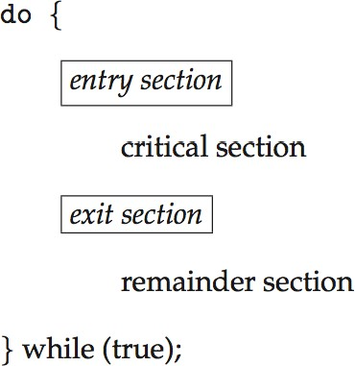
Critical Section(CO3)
General structure of process P_{i}

Slide 32
Algorithm for Process P_{i}(CO3)
do {
while (turn == j);
critical section
turn = j;
remainder section
} while (true);

Slide 33
Solution to critical section problem
Mutual Exclusion - If process P_{i} is executing in its critical section, then no other processes can be executing in their critical sections
Progress - If no process is executing in its critical section and there exist some processes that wish to enter their critical section, then the selection of the processes that will enter the critical section next cannot be postponed indefinitely
Bounded Waiting -A bound must exist on the number of times that other processes are allowed to enter their critical sections after a process has made a request to enter its critical section and before that request is granted

Slide 34
Solution to critical section problem
Mutual Exclusion - If process P_{i} is executing in its critical section, then no other processes can be executing in their critical sections
Progress- If no process is executing in its critical section and there exist some processes that wish to enter their critical section, then the selection of the processes that will enter the critical section next cannot be postponed indefinitely
Bounded Waiting -A bound must exist on the number of times that other processes are allowed to enter their critical sections after a process has made a request to enter its critical section and before that request is granted

Slide 35
Daily Quiz
Q1. What is the primary purpose of a critical section in concurrent programming?
To execute I/O operations (b) To prevent deadlock (c) To ensure mutual exclusion while accessing shared resources (d) To speed up the execution of processes
Q2.Which of the following is NOT a requirement for a solution to the Critical Section Problem?
(a) Mutual Exclusion (b) Progress (c) Bounded Waiting (d) Deadlock Prevention

Slide 36
Daily Quiz
Q3. Which of the following algorithms does not guarantee mutual exclusion?
Dekker’s Algorithm (b) Peterson’s Algorithm (c) Bakery Algorithm (d) Round Robin Scheduling
Q4. In which scenario is a race condition likely to occur?
When two threads run independently (b) When no thread accesses shared resources (c) When multiple threads access shared data without synchronization (d) When a single thread accesses shared data
Q5. Which of the following is used to implement critical section handling?
(a) Compiler (b) Scheduler (c) Synchronization mechanisms like mutexes and semaphores (d) Disk Scheduling Algorithms

Slide 37
Inter-process Communication(CO3)
Cooperating processes need interprocess communication (IPC) mechanism that will allow them to exchange data and information
Two models of IPC
Shared memory:
a region of memory that is shared by cooperating processes is established
processes can exchange information by reading and writing data to the shared region
Message passing:
communication takes place by means of messages exchanged between the cooperating processes.

Slide 38
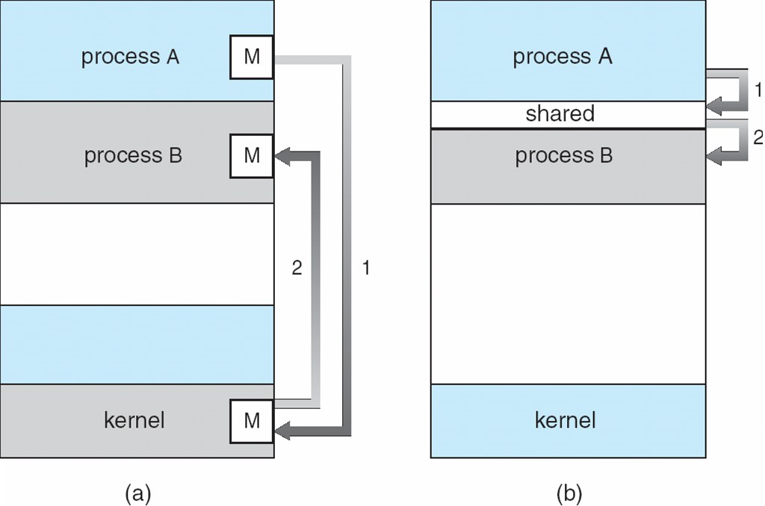
Communications Models(CO3)

Slide 39
Shared memory vs. Message Passing(CO3)
Message Passing is useful for exchanging smaller amounts of data easier to implement for inter-computer communication
Shared memory is faster as message passing systems are typically implemented using system calls and thus require the kernel intervention in shared-memory systems, systems calls are required only to establish shared-memory regions and all accesses are treated as classical memory accesses and no assistance from the kernel is required.

Slide 40
Shared Memory (CO3)
Shared memory allows multiple processes to share virtual memory space
This is the fastest but not necessarily the easiest way for processes to communicate with one another
In general, one process creates or allocates the shared memory segment
The size and access permissions for the segment are set when it is created
The process then attaches the shared segment, causing it to be mapped into its current data space
If needed, the creating process then initializes the shared memory

Slide 41
Shared Memory (cont.) (CO3)
Once created, and if permissions permit, other processes can gain access to the shared memory segment and map it into their data space
Each process accesses the shared memory relative to its attachment address
While the data that these processes are referencing is in common, each process uses different attachment address values
For each process involved, the mapped memory appears to be no different from any other of its memory addresses.

Slide 42
Message Passing(CO3)
Message Passing provides a mechanism for processes to communicate and to synchronize their actions without sharing the same address space.
IPC facility provides two operations:
send (message)
receive (message)
If P and Q wish to communicate, they need to:
establish a communication link between them
exchange messages via send/receive

Slide 43
Direct Communication(CO3)
Each process that wants to communicate must explicitly name the recipient or sender of the communication:
send (P, message) – send a message to process P
receive(Q, message) – receive a message from process Q
Properties of communication link
Links are established automatically
A link is associated with exactly one pair of communicating processes
The link may be unidirectional, but it is usually bi-directional

Slide 44
Indirect Communication(CO3)
Messages are directed and received from mailboxes (also known as
ports)
Primitives are defined as:
send(A, message) – send a message to mailbox A
receive(A, message) – receive a message from mailbox A
A mailbox can be viewed abstractly as an object into which messages can be placed by processes and from which messages can be removed
each mailbox has a unique id
processes can communicate only if they share a mailbox
a communication link may be associated with many processes
each pair of processes may share several communication links
link may be unidirectional or bi-directional

Slide 45
Process Synchronization using Lock Variable
Definition: A lock variable is the simplest synchronization mechanism used to control access to a critical section in concurrent processes.
It ensures that only one process enters the critical section at a time.
AlgorithmHere’s how it typically works:
Initializationlock = 0; // critical section is free
2. Entry Sectionwhile (lock == 1) ; // busy wait until lock is freelock = 1; // acquire lock
3. Critical Section// perform operations in the critical section
4. Exit Sectionlock = 0; // release lock

Slide 46
Process Synchronization using Lock Variable
Example :-
int lock = 0; // shared variable
void process() {
while (1) {
// Entry Section
while (lock == 1); // wait until lock is free
lock = 1; // acquire lock
// Critical Section
printf("Process in critical section\n");
// Exit Section
lock = 0; // release lock
}
}

Slide 47
Process Synchronization using Lock Variable
-Works only in theory for single-processor systems.
-Modern systems use atomic operations like Test-and-Set, Semaphore, or Mutex instead.
-A lock variable is a basic idea for process synchronization but not reliable in real-world concurrent systems due to race conditions and inefficiency.

Slide 48
Peterson’s Solution(CO3)
Good algorithmic description of solving the problem
Two process solution
The two processes share two variables:
int turn;
Boolean flag[2]
The variable turn indicates whose turn it is to enter the critical section
The flag array is used to indicate if a process is ready to enter the critical section. flag[i] = true implies that process P_{i} is ready!
Operating System Concepts

Slide 49
Peterson’s Solution
Definition:
-Peterson’s solution is a classic software-based algorithm for process synchronization.
-It allows two processes to share a critical section without conflict, ensuring mutual exclusion, progress, and bounded waiting.
-It is mainly used for two processes (say P0 and P1).
Key Shared Variablesflag[2]:
flag[0] = true → Process P0 wants to enter critical section
flag[1] = true → Process P1 wants to enter critical section
turn:
Indicates whose turn it is to enter the critical section.

Slide 50
Process P1
Peterson’s Solution
Algorithm
1.Initialization
boolean flag[2] = {false, false};
int turn;
2. Process P0
while (true) {
flag[0] = true; // P0 wants to enter
turn = 1; // Give chance to P1
while (flag[1] && turn == 1); // Wait if P1 also wants to enter
// Critical Section
printf("P0 in Critical Section\n");
flag[0] = false; // Exit section
// Remainder Section
}

Slide 51
Process P1
Peterson’s Solution
3. Process P1
while (true) {
flag[1] = true; // P1 wants to enter
turn = 0; // Give chance to P0
while (flag[0] && turn == 0); // Wait if P0 also wants to enter
// Critical Section
printf("P1 in Critical Section\n");
flag[1] = false; // Exit section
// Remainder Section
}

Slide 52
Process P1
Peterson’s Solution
Advantages
✅ Simple and easy to implement ✅ Guarantees mutual exclusion, progress, and bounded waiting ✅ Requires no hardware support
Disadvantages
❌ Works only for two processes ❌ Relies on busy waiting (wastes CPU time) ❌ May fail on modern multi-core systems due to compiler optimizations or instruction reordering (not strictly atomic).
Real-world Usage
Peterson’s algorithm is mainly a theoretical model for teaching synchronization. In practice, modern systems use hardware-supported mechanisms like:
Mutex Locks
Semaphores
Monitors

Slide 53
Process P1
Strict Alternation
Definition:
-Strict Alternation is one of the simplest software-based process synchronization techniques used to enforce mutual exclusion between two processes that share a critical section.
-It alternates access to the critical section strictly, meaning that after one process finishes, the other process must execute next, even if it does not need the critical section.
A shared variable turn is used:
turn = 0 → It's Process P0's turn.
turn = 1 → It's Process P1's turn.

Slide 54
Process P1
Strict Alternation
A shared variable turn is used:
turn = 0 → It's Process P0's turn.
turn = 1 → It's Process P1's turn.
Algorithm
1.Initialization
int turn = 0; // Start with process P0
2. Process P0
while (true) {
while (turn != 0); // Wait until i
t's P0's turn
// Critical Section
printf("P0 in Critical Section\n");
turn = 1; // Pass turn to P1
// Remainder Section
}

Slide 55
Process P1
Strict Alternation
3. Process P1
while (true) {
while (turn != 1); // Wait until it's P1's turn
// Critical Section
printf("P1 in Critical Section\n");
turn = 0; // Pass turn to P0
// Remainder Section
}
Problems with Strict Alternation
-Wasted CPU Time: Busy waiting while checking the turn.
-No True Progress: If P0 is in the remainder section but turn=0, P1 will keep waiting unnecessarily.
-Not Efficient: Does not adapt to real process needs.

Slide 56
Sleeping Barber Problem
The Sleeping Barber Problem is a classic synchronization problem that illustrates issues of process synchronization and inter-process communication (IPC). It was first introduced by Dijkstra and is commonly solved using semaphores.
Problem Description
A barbershop has:
-One barber
-One barber chair (where haircuts happen)
-A waiting room with a limited number of chairs (say n chairs).

Slide 57
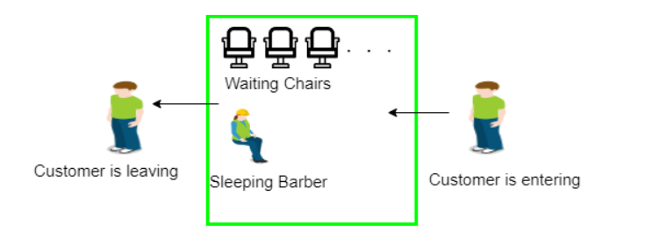
Sleeping Barber Problem

Slide 58
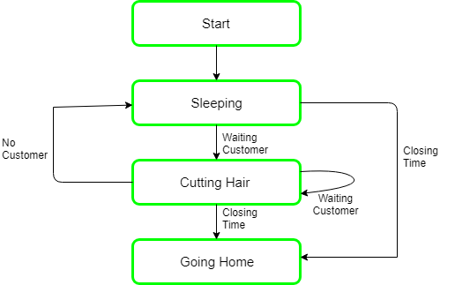
Sleeping Barber Problem Solution

Slide 59
Sleeping Barber Problem
Behavior of the system:
-If there are no customers, the barber sleeps in the chair.
-When a customer enters:
-If the barber is sleeping, the customer wakes the barber up.
-If the barber is busy and there is a free chair, the customer waits in the waiting area.
-If the waiting area is full, the customer leaves the shop.
. Key Challenges
--Ensuring mutual exclusion so that no two customers occupy the same chair.
-Coordinating the barber and customer processes to avoid deadlock or starvation.

Slide 60
Sleeping Barber Problem
Real-World Applications
-Thread scheduling in operating systems.
-Resource allocation in multi-threaded applications.
-Producer-consumer style problems where consumers wait for resources.
Drawbacks
-Busy waiting may still occur if not implemented carefully.
More complex for multiple barbers or dynamic chair allocation.

Slide 61
Deadlock Introduction(C03)
In a multiprogramming environment, several processes may compete for a finite number of resources. A process requests resources; if the resources are not available at that time, the process enters a wait state. Waiting processes may never again change state, because the resources they have requested are held by other waiting processes. This situation is called a deadlock.
A set of processes is in a deadlock state if every process in the set is waiting for an event (release) that can only be caused by some other process in the same set.
Example
-System has 2 disk drives
-P1 and P2 process each hold one disk drive and each needs another one

Slide 62
Producer-Consumer Problem(CO3)
Unbounded-buffer places no practical limit on the size of buffer.
Bounded-buffer assumes that there is a fixed buffer size.
Producer code
while (true) {
/* produce an item in next produced */
while (counter == BUFFER_ SIZE) ;
/* do nothing */
buffer[in] = next_produced;
in = (in + 1) %BUFFER_SIZE;
counter++;
}

Slide 63
Producer-Consumer Problem(CO3)
Consumer code
while (true) {
while (counter == 0);
/* do nothing */
next_consumed = buffer[out];
out = (out + 1) % BUFFER_SIZE;
counter--;
/* consume the item in next consumed */
}

Slide 64
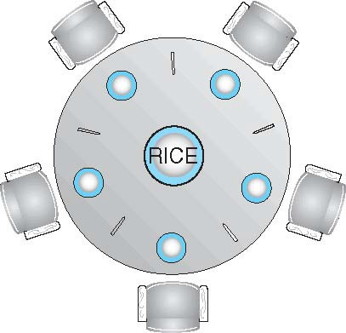
Dining-Philosophers Problem(CO3)

Slide 65
Dining-Philosophers Problem(CO3)
Philosophers spend their lives alternating thinking and eating
Don’t interact with their neighbors, occasionally try to pick up 2 chopsticks (one at a time) to eat from bowl
Need both to eat, then release both when done
In the case of 5 philosophers
Shared data
Bowl of rice (data set)
Semaphore chopstick [5] initialized to 1

Slide 66
Dining-Philosophers Problem Algorithm(CO3)
The structure of Philosopher i:
do {
wait (chopstick[i] );
wait (chopStick[ (i + 1) % 5] );
// eat signal (chopstick[i] );
signal (chopstick[ (i + 1) % 5] );
// think
} while (TRUE);
What is the problem with this algorithm?

Slide 67
Dining-Philosophers Problem Algo. (Cont) (CO3)
Deadlock handling
Allow at most 4 philosophers to be sitting simultaneously at the table.
Allow a philosopher to pick up the forks only if both are available (picking must be done in a critical section).
Use an asymmetric solution-- an odd-numbered philosopher picks up first the left chopstick and then the right chopstick. Even-numbered philosopher picks up first the right chopstick and then the left chopstick.

Slide 68
Readers-Writers Problem(CO3)
A data set is shared among a number of concurrent processes
Readers – only read the data set; they do not perform any updates
Writers – can both read and write
Problem – allow multiple readers to read at the same time
Only one single writer can access the shared data at the same time
Several variations of how readers and writers are considered -all involve some form of priorities
Shared Data
Data set
Semaphore rw_mutex initialized to 1
Semaphore mutex initialized to 1
Integer read_count initialized to 0

Slide 69
Readers-Writers Problem (Cont.) (CO3)
The structure of a writer process
Do
{
wait(rw_mutex);
...
/* writing is performed */
...
signal(rw_mutex);
}
while (true);

Slide 70
Algorithm for Process P_{i}(CO3)
do{
flag[i] = true;
turn = j;
while (flag[j] && turn = = j);
critical section
flag[i] = false;
remainder section
} while (true);
Provable that the three CS requirement are met:
Mutual exclusion is preserved
P_{i} enters CS only if:
either flag[j] = false or turn = i
Progress requirement is satisfied
Bounded-waiting requirement is met

Slide 71
Semaphore(CO3)
Synchronization tool that provides more sophisticated ways for process to synchronize their activities.
Semaphore S – integer variable
Can only be accessed via two indivisible (atomic) operations
wait() and signal()
Definition of the wait()operation
wait(S) {
while (S <= 0)
; // busy wait S--;
}
Definition of the signal() operation signal(S) {
S++;
}

Slide 72
Semaphore Usage(CO3)
Counting semaphore – integer value can range over an unrestricted domain
Binary semaphore – integer value can range only between 0 and 1
Can solve various synchronization problems
Consider P₁ and P₂ that require S₁ to happen before S₂
Create a semaphore “synch” initialized to 0
P1:
S₁;
signal(synch); P2:
wait(synch); S₂;
Can implement a counting semaphore S as a binary semaphore
Operating System Concets

Slide 73
Semaphore Implementation
Must guarantee that no two processes can execute the wait()and signal() on the same semaphore at the same time
Thus, the implementation becomes the critical section problem where the wait and signal code are placed in the critical section
Could now have busy waiting in critical section implementation
But implementation code is short
Little busy waiting if critical section rarely occupied
Note that applications may spend lots of time in critical sections and therefore this is not a good solution

Slide 74
Classical Problems of Synchronization(CO3)
Classical problems used to test newly-proposed synchronization schemes
Bounded-Buffer Problem
Readers and Writers Problem
Dining-Philosophers Problem

Slide 75
Bounded Buffer Problem
n buffers, each can hold one item
Semaphore mutex initialized to the value 1
Semaphore full initialized to the value 0
Semaphore empty initialized to the value n

Slide 76
Bounded Buffer Problem (Cont.) (CO3)
The structure of the producer process
do {
...
/* produce an item in next_produced */
...
wait(empty); wait(mutex);
...
/* add next_produced to the buffer */
...
signal(mutex); signal(full);
}while(true);

Slide 77
Bounded Buffer Problem (Cont.) (CO3)
The structure of the consumer process
do {
wait(full); wait(mutex);
...
/* remove an item from buffer to next_consumed */
...
signal(mutex); signal(empty);
...
/* consume the item in next consumed */
...
}while(true);

Slide 78
Problems with Semaphores(CO3)
Incorrect use of semaphore operations:
signal (mutex) …. wait (mutex)
wait (mutex) … wait (mutex)
Omitting of wait (mutex) or signal (mutex) (or both)
Deadlock and starvation are possible.

Slide 79
System Model
A system consists of a finite number of resources to be distributed among a number of competing processes. The resources are partitioned into several types, each of which consists of some number of identical instances.
Memory space, CPU cycles, files and I/O devices (printers, tape drives) are examples of resource types.
A process must request a resource before using it, and must release the resource after using it.
Under the normal mode of operation, a process may utilize a resource in only the following sequence.
Request: if the request can not be granted immediately then the requesting process must wait until it can acquire the resource.
2. Use: The process can operate on the resource (for example, if the resource is a printer, the process can print on the printer)
3. Release: The process releases the resource.

Slide 80
Deadlock Characterization (CO3)
Deadlock can arise if four conditions hold simultaneously
Mutual exclusion: only one process at a time can use a resource.
Hold and wait: a process holding at least one resource and is waiting to acquire additional resources held by other processes.
No preemption: a resource can be released only voluntarily by the process holding it, after that process has completed its task.
Circular wait: there exists a set {P0, P1, …, Pn} of waiting processes such that P0 is waiting for a resource that is held by P1, P1 is waiting for a resource that is held by P2, …, Pn–1 is waiting for a resource that is held by Pn, and Pn is waiting for a resource that is held by P0.

Slide 81
Resource-Allocation Graph(CO3)
A resource allocation graph is a set of vertices V and a set of edges E such that:
V is partitioned into two types:
P = {P1, P2, …, Pn}, the set consisting of all the processes in the system
R = {R1, R2, …, Rm}, the set consisting of all resource types in the system
request edge – directed edge P_{i} → R_{j}
assignment edge – directed edge R_{j} → P_{i}

Slide 82
Resource-Allocation Graph(CO3)
Process
Resource Type with 4 instances
P_{i} requests instance of R_{j}
P_{i} is holding an instance of R_{j}
P_{i}
Pi

Slide 83
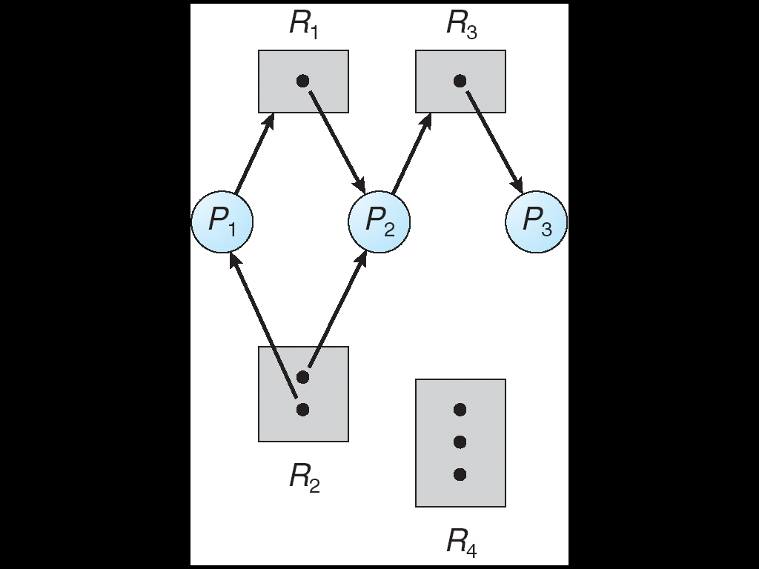
Resource-Allocation Graph(CO3)
Resource allocation graph

Slide 84
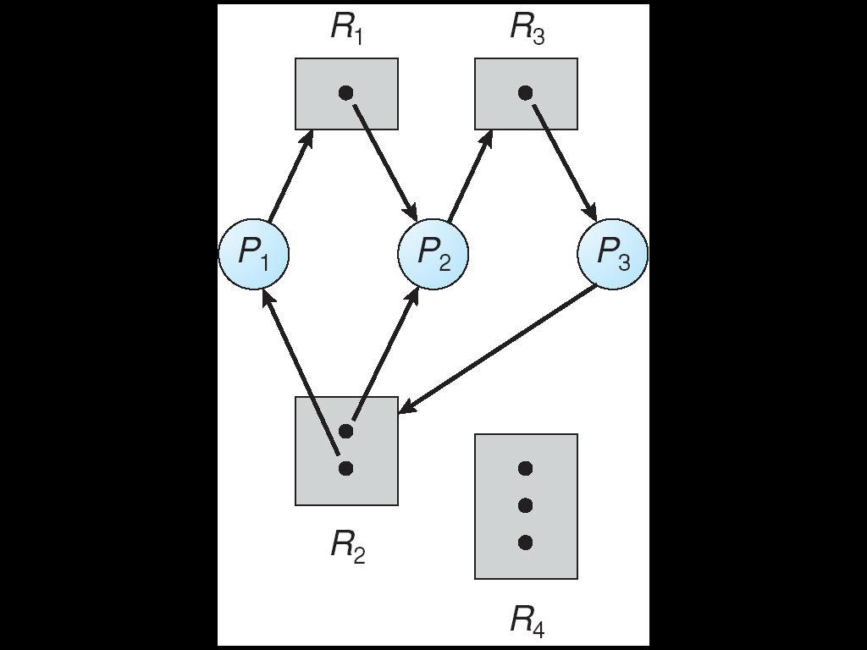
Resource Allocation Graph With A Deadlock(C03)
After P₃ requested an instance of R₂
Cycle-1
P1→R1→P2→R3→P3→R2→P1
Cycle-2
P2→R3→P3→R2→P2
A Cycle In the Graph May cause Deadlock

Slide 85
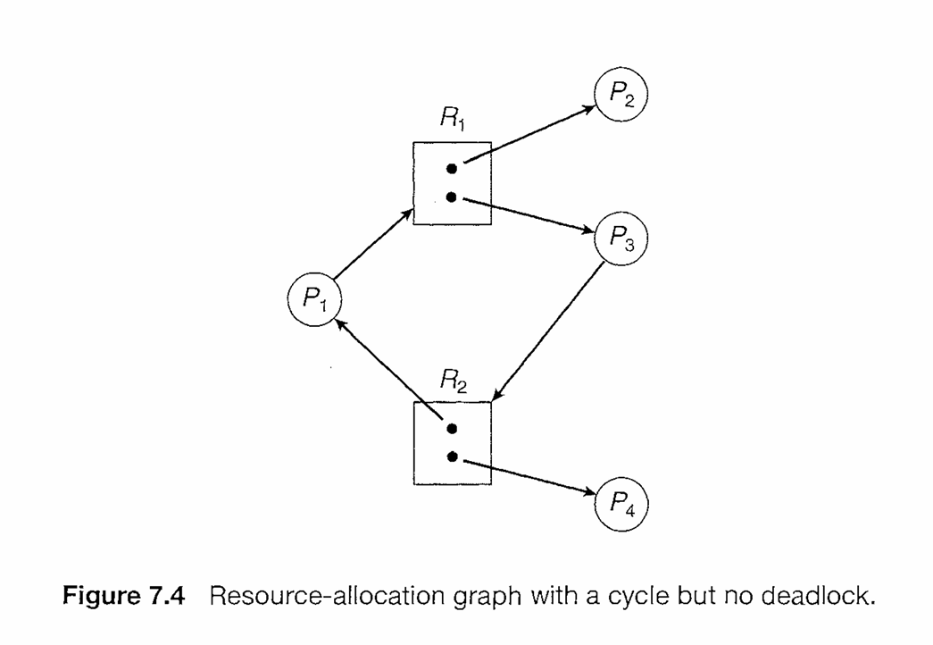
Resource Allocation Graph (C03)

Slide 86
Summary(C03)
If graph contains no cycles ⇒ no deadlock
If graph contains a cycle ⇒
if only one instance per resource type, then deadlock
if several instances per resource type, possibility of deadlock

Slide 87
Methods for Handling Deadlocks(CO3)
Prevention
Ensure that the system will never enter a deadlock state
Avoidance
Ensure that the system will never enter an unsafe state
Detection
Allow the system to enter a deadlock state and then recover
Do Nothing
Ignore the problem and let the user or system administrator respond to the problem; used by most operating systems, including Windows and UNIX

Slide 88
Deadlock Prevention(CO3)
To prevent deadlock, we can restrain the ways that a request can be made
Do not allow one of the four conditions to occur
Mutual Exclusion :
if no resource were ever assigned to a single process exclusively, we would never have deadlock.
Shared entities (read only files) don't need mutual exclusion (and aren’t susceptible to deadlock.)
Prevention not possible, since some devices are naturally non-sharable

Slide 89
Deadlock Prevention(CO3)
Hold And Wait :
we must guarantee that whenever a process requests a resource, it does not hold any other resources
Require a process to request and be allocated all its resources before it begins execution
allow a process to request resources only when the process has none
Result: Low resource utilization; starvation possible

Slide 90
Deadlock Prevention(CO3)
No Preemption :
If a process that is holding some resources requests another resource that cannot be immediately allocated to it, then all resources currently being held are released
Pi → Rj → Pj → Rk
A process will be restarted only when it can regain its old resources, as well as the new ones that it is requesting.
Allow preemption - if a needed resource is held by another process, which is also waiting on some resource, steal it. Otherwise wait.
Circular Wait :
Impose a total ordering of all resource types, and require that each process requests resources in an increasing order of enumeration.

Slide 91
Deadlock Avoidance(CO3)
Requires that the system has some additional apriori information available.
Simplest and most useful model requires that each process declare the maximum number of resources of each type that it may need.
The deadlock-avoidance algorithm dynamically examines the resource-allocation state to ensure that there can never be a circular-wait condition.
Resource-allocation state is defined by the number of available and allocated resources, and the maximum demands of the processes.

Slide 92
Safe State(CO3)
When a process requests an available resource, system must decide if immediate allocation leaves the system in a safe state
System is in safe state if there exists a sequence <P₁, P₂, …, P_{n}> of all the processes in the systems such that for each P_{i}, the resources that P_{i} can still request can be satisfied by currently available resources + resources held by all the P_{j}, with j < i
That is:
If P_{i} resource needs are not immediately available, then P_{i} can wait until all P_{j} have finished
When P_{j} is finished, P_{i} can obtain needed resources, execute, return allocated resources, and terminate
When P_{i} terminates, P_{i +1} can obtain its needed resources, and so on

Slide 93
Safe State(CO3)
If a system is in safe state ⇒ no deadlocks
If a system is in unsafe state ⇒ possibility of deadlock
Avoidance ⇒ ensure that a system will never enter an unsafe state.

Slide 94
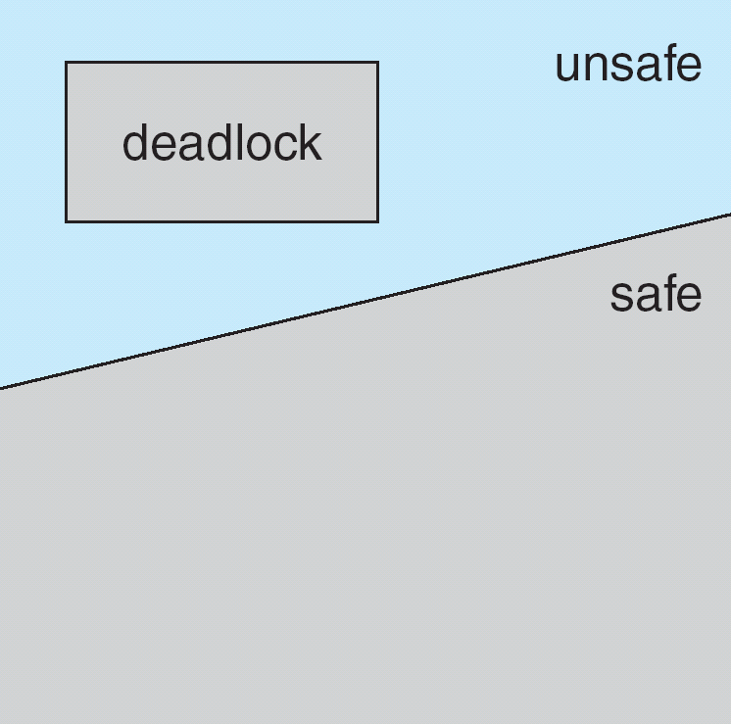
Safe State(CO3)

Slide 95
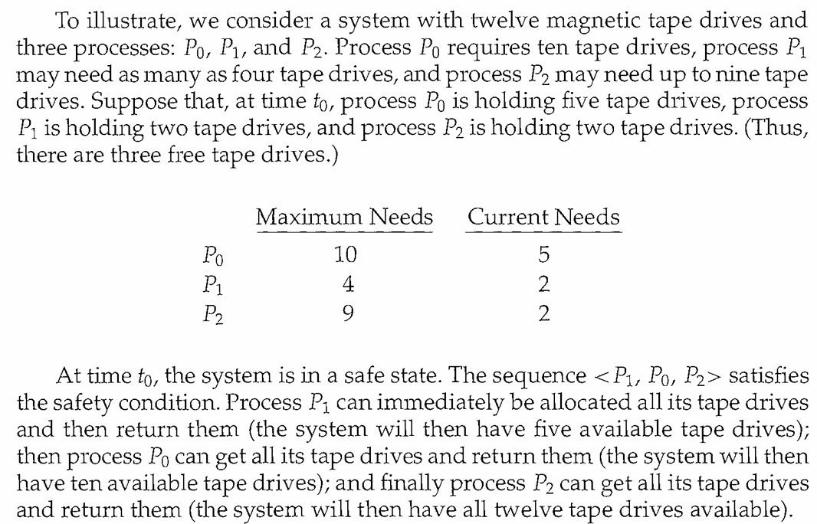
Safe State(CO3)

Slide 96
Avoidance algorithms(CO3)
For a single instance of a resource type, use a resource-allocation graph
For multiple instances of a resource type, use the banker’s algorithm

Slide 97
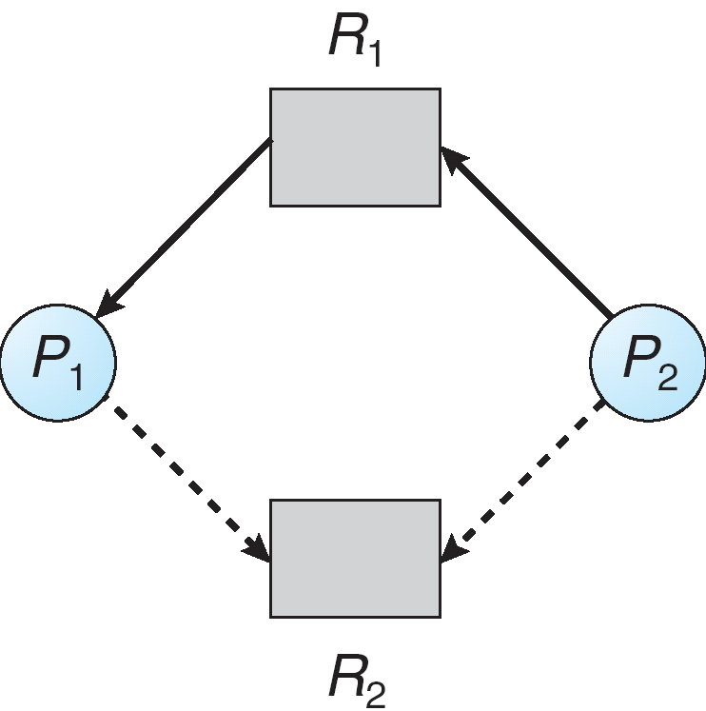
Resource-Allocation Graph with Claim Edges(CO3)
Assignment
edge
Request
edge
Claim
edge
Claim
edge

Slide 98
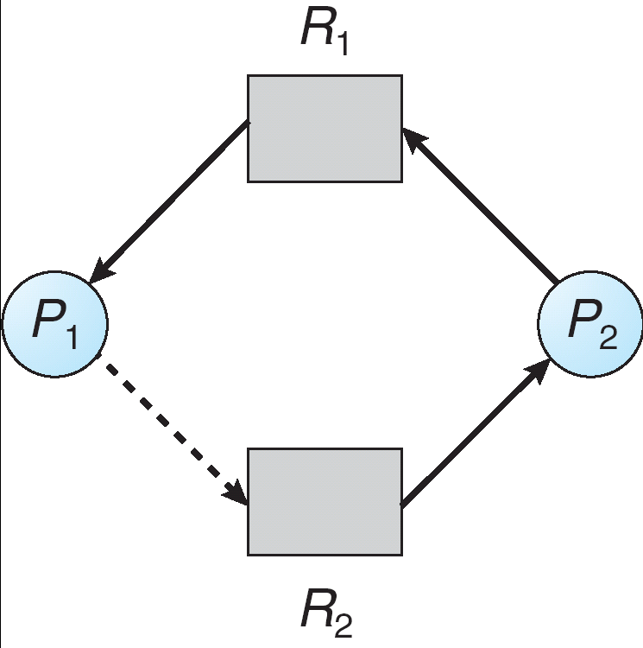
Unsafe State In Resource-Allocation Graph (CO3)
Assignment
edge
Request
edge
Assignment
edge
Claim
edge

Slide 99
Resource-Allocation Graph Algorithm(CO3)
Suppose that process P_{i} requests a resource R_{j}
The request can be granted only if converting the request edge to an assignment edge does not result in the formation of a cycle in the resource allocation graph

Slide 100
Banker’s Algorithm(CO3)
Multiple instances
Each process must apriori claim maximum use
When a process requests a resource it may have to wait
When a process gets all its resources it must return them in a finite amount of time

Slide 101
Data Structures for the Banker’s Algorithm (CO3)
Let n = number of processes, and m = number of resource types.
Available: Vector of length m. If available [j] = k, there are k instances of resource type R_{j} available.
Max: n x m matrix. If Max [i,j] = k, then process P_{i} may request at most k instances of resource type R_{j}.
Allocation: n x m matrix. If Allocation[i,j] = k then P_{i} is currently allocated k instances of R_{j.}
Need: n x m matrix. If Need[i,j] = k, then P_{i} may need k more instances of R_{j} to complete its task.

Slide 102
Safety Algorithm(CO3)
1.Let Work and Finish be vectors of length m and n, respectively.
Initialize:
Work = Available
Finish [i] = false for i = 0, 1, …, n- 1
2.Find an i such that both:
(a) Finish [i] = false
(b) Need_{i} ≤ Work
If no such i exists, go to step 4
3. Work = Work + Allocation_{i} Finish[i] = true go to step 2
4.If Finish [i] == true for all i, then the system is in a safe state

Slide 103
Resource-Request Algorithm for Process P_{i}(CO3)
Request_{i} = request vector for process P_{i}. If Request_{i} [j] = k then process P_{i} wants k instances of resource type R_{j}
1. If Request_{i} ≤ Need_{i} go to step 2. Otherwise, raise error condition, since process has exceeded its maximum claim
2. If Request_{i} ≤ Available, go to step 3. Otherwise P_{i} must wait, since resources are not available
3. Pretend to allocate requested resources to P_{i} by modifying the state as follows:
Available = Available – Request_{i};
Allocation_{i} = Allocation_{i} + Request_{i};
Need_{i} = Need_{i} – Request_{i};
If safe ⇒ the resources are allocated to P_{i}
If unsafe ⇒ P_{i} must wait, and the old resource-allocation state is restored

Slide 104
Example of Banker’s Algorithm(CO3)
5 processes P₀ through P₄;
3 resource types:
A (10 instances), B (5 instances), and C (7 instances)
Snapshot at time T₀:
Allocation Max Available
A B C A B C A B C
P₀ 0 1 0 7 5 3 3 3 2
P₁ 2 0 0 3 2 2
P₂ 3 0 2 9 0 2
P₃ 2 1 1 2 2 2
P₄ 0 0 2 4 3 3

Slide 105
Example (Cont.)(CO3)
The content of the matrix Need is defined to be Max – Allocation
Need
A B C
P₀ 7 4 3
P₁ 1 2 2
P₂ 6 0 0
P₃ 0 1 1
P₄ 4 3 1
The system is in a safe state since the sequence < P₁, P₃, P₄, P₂, P₀> satisfies safety criteria

Slide 106
Example: (CO3)
P₁ Request (1,0,2)
Check that Request ≤ Available (that is, (1,0,2) ≤ (3,3,2) ⇒ true
Allocation Need Available
A B C A B C A B C
P₀ 0 1 0 7 4 3 2 3 0
P₁ 3 0 2 0 2 0
P₂ 3 0 2 6 0 0
P₃ 2 1 1 0 1 1
P₄ 0 0 2 4 3 1
Executing safety algorithm shows that sequence < P₁, P₃, P₄, P₀, P₂> satisfies safety requirement

Slide 107
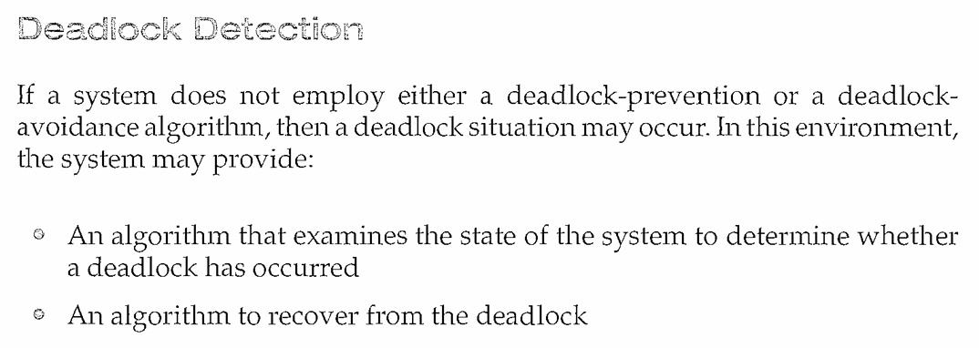
Deadlock Detection(CO3)

Slide 108
Single Instance of Each Resource Type(CO3)
Maintain wait-for graph
Nodes are processes
P_{i} → P_{j} if P_{i} is waiting for P_{j}
Periodically invoke an algorithm that searches for a cycle in the graph. If there is a cycle, there exists a deadlock
An algorithm to detect a cycle in a graph requires an order of n² operations, where n is the number of vertices in the graph

Slide 109
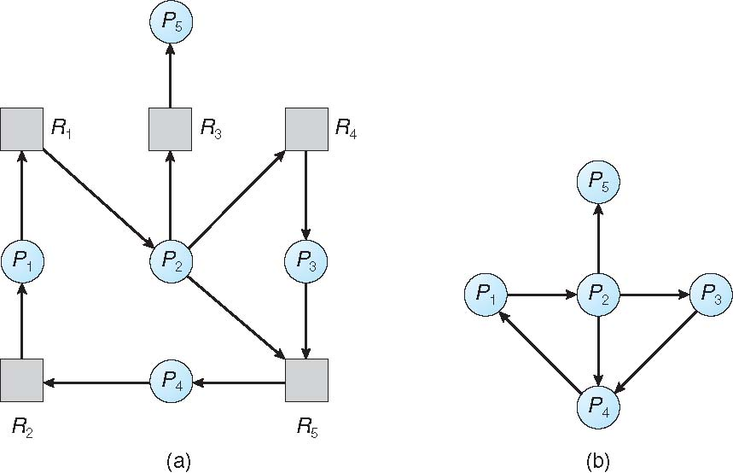
Single Instance of Each Resource Type(CO3)
Resource-Allocation Graph
Corresponding wait-for graph

Slide 110
Several Instances of a Resource Type(CO3)
Available: A vector of length m indicates the number of available resources of each type
Allocation: An n x m matrix defines the number of resources of each type currently allocated to each process
Request: An n x m matrix indicates the current request of each process. If Request [i][j] = k, then process P_{i} is requesting k more instances of resource type R_{j}.

Slide 111
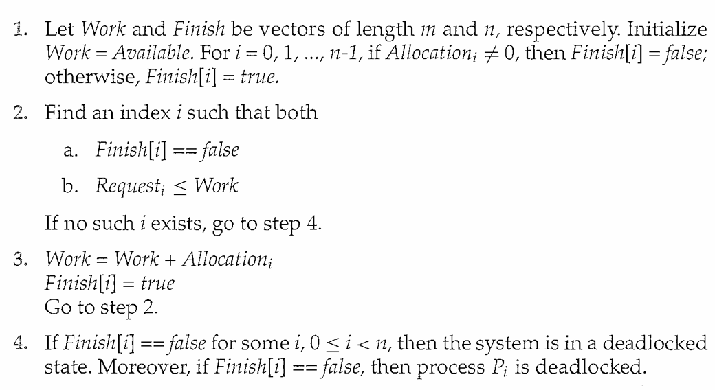
Detection Algorithm(CO3)

Slide 112
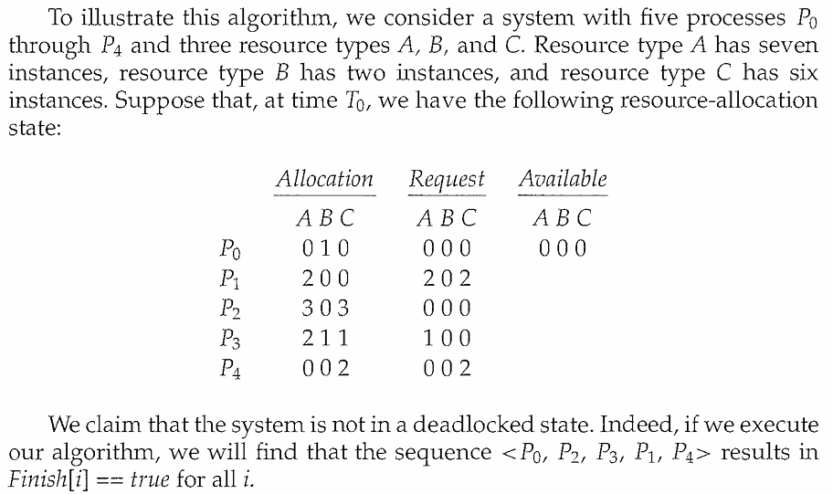
Detection Algorithm(CO3)

Slide 113
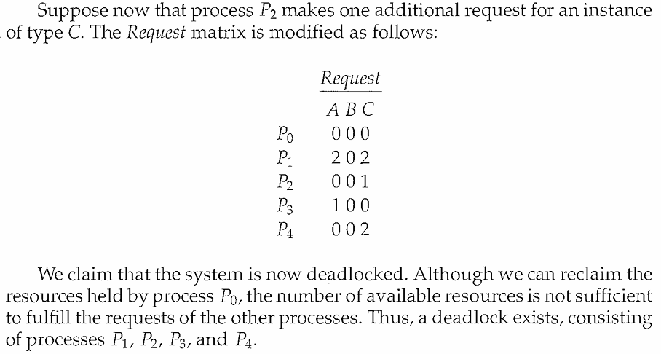
Detection Algorithm(CO3)

Slide 114
Recovery from Deadlock(CO3)
Process Termination :
Abort all deadlocked processes
Abort one process at a time until the deadlock cycle is eliminated
In which order should we choose to abort?
Priority of the process
How long process has computed, and how much longer to completion
Resources the process has used
Resources process needs to complete
How many processes will need to be terminated
Is process interactive or batch?

Slide 115
Recovery from Deadlock(CO3)
Resource Preemption :
Selecting a victim – minimize cost
Rollback – return to some safe state, restart process for that state
Starvation – same process may always be picked as victim, include number of rollback in cost factor

Slide 116
Case Study: Deadlock avoidance in database transaction management systems like Oracle or MySQL
Case Study 1: Deadlock Avoidance in Oracle Database
Scenario: Banking Transaction System
A bank maintains multiple accounts, and two transactions are executed simultaneously:
Transaction T1: Transfers ₹10,000 from Account A → Account B
Transaction T2: Transfers ₹15,000 from Account B → Account A
Problem:
T1 locks Account A first, then requests a lock on Account B.
T2 locks Account B first, then requests a lock on Account A.
This leads to a circular wait condition → potential deadlock.

Slide 117
Case Study: Deadlock avoidance in database transaction management systems like Oracle or MySQL
Case Study 1: Oracle Database Deadlock
Transaction 1 (T1):
BEGIN;
UPDATE employees SET salary = salary + 5000 WHERE id = 101;
UPDATE employees SET salary = salary + 3000 WHERE id = 202;
COMMIT;
Transaction 2 (T2):
BEGIN;
UPDATE employees SET salary = salary + 3000 WHERE id = 202;
UPDATE employees SET salary = salary + 5000 WHERE id = 101;
COMMIT;

Slide 118
Case Study: Deadlock avoidance in database transaction management systems like Oracle or MySQL
T1 locks employee 101 and waits for employee 202.
T2 locks employee 202 and waits for employee 101
This forms a circular wait:
T1 → Employee 202 → T2 → Employee 101 → T1
Resolution
Oracle detects the cycle in the wait-for graph.
Rolls back one transaction (e.g., T2) and shows:

Slide 119
Case Study: Deadlock avoidance in database transaction management systems like Oracle or MySQL
Case Study 2: MySQL (InnoDB) Deadlock
Transaction 1 (T1):
START TRANSACTION;
UPDATE accounts SET balance = balance - 1000 WHERE acc_no = 101;
UPDATE accounts SET balance = balance + 1000 WHERE acc_no = 202;
COMMIT;
Transaction 2 (T2):
START TRANSACTION;
UPDATE accounts SET balance = balance - 500 WHERE acc_no = 202;
UPDATE accounts SET balance = balance + 500 WHERE acc_no = 101;
COMMIT;

Slide 120
Case Study: Deadlock avoidance in database transaction management systems like Oracle or MySQL
Deadlock Formation
T1 locks acc_no 101 → waits for acc_no 202.T2 locks acc_no 202 → waits for acc_no 101.
T2 locks acc_no 202 → waits for acc_no 101.
Resolution
MySQL InnoDB detects the deadlock.
Rolls back the transaction with lesser work done (e.g., T2) and throws:

Slide 121
Daily Quiz
1. Semaphore is a/an _______ to solve the critical section problem.
hardware for a system
special program for a system
integer variable
none of the mentioned.
2.Bounded waiting implies that there exists a bound on the number of times a process is allowed to enter its critical section ____________
after a process has made a request to enter its critical section and before the request is granted
when another process is in its critical section
before a process has made a request to enter its critical section
none of the mentioned

Slide 122
Daily Quiz
3. When several processes access the same data concurrently and the outcome of the execution depends on the particular order in which the access takes place, is called?
A. dynamic condition B. race condition C. essential condition D. critical condition
4. Mutual exclusion can be provided by the __________
A. mutex locks B. binary semaphores C. both mutex locks and binary semaphores D. none of the mentioned

Slide 123
Daily Quiz
5. Which process can be affected by other processes executing in the system?
A. Cooperating process
B. child process C. parent process D. init process
6. If a process is executing in its critical section, then no other processes can be executing in their critical section. This condition is called?
Mutual exclusion
critical exclusion
synchronous exclusion
asynchronous exclusion

Slide 124
Daily Quiz
7. Concurrent access to shared data may result in ____________
data consistency
data insecurity
data inconsistency
none of the mentioned
8. Which of the following conditions must be satisfied to solve the critical section problem?
Mutual Exclusion
Progress
Bounded Waiting
All of the mentioned

Slide 125
Weekly Assignment
Name some classic problem of synchronization?
Define entry section and exit section?
What are the requirements that a solution to the critical section problem must satisfy?
Explain two primitive semaphore operations?

Slide 126
Subject videos and Links
Youtube/other Video Links
https://www.youtube.com/watch?v=_zOTMOubT1M
https://www.youtube.com/playlist?list=PLmXKhU9FNesSFvj6gASuWmQd23Ul5omtD
https://www.youtube.com/watch?v=x_UpLHXF9dU
https://www.youtube.com/watch?v=cviEfwtdcEE
https://nptel.ac.in/courses/106108101

Slide 127
MCQs
1. Semaphore is a/an _______ to solve the critical section problem.
hardware for a system
special program for a system
integer variable
none of the mentioned
2. What are the two atomic operations permissible on semaphores?
Wait
Stop
Hold
none of the mentioned

Slide 128
MCQs
3. Peterson's solution can be applied for how many process?
4
3
2
Any number of processes
4. Semaphore is a _________ based solution
Software
Hardware
Both software and hardware
None

Slide 129
MCQs
5. The switching of the CPU from one process or thread to another is called ____________
process switch
task switch
context switch
all of the mentioned
6. If no cycle exists in the resource allocation graph ____________
then the system will not be in a safe state
then the system will be in a safe state
all of the mentioned
none of the mentioned

Slide 130
MCQs
7. The dining – philosophers problem will occur in case of ____________
5 philosophers and 5 chopsticks
4 philosophers and 5 chopsticks
3 philosophers and 5 chopsticks
6 philosophers and 5 chopstick
8. In the bounded buffer problem ____________
there is only one buffer
there are n buffers ( n being greater than one but finite)
there are infinite buffers
the buffer size is bounded

Slide 131
MCQs
9. To ensure difficulties do not arise in the readers – writers problem _______ are given exclusive access to the shared object.
Readers
Writers
readers and writers
none of the mentioned
10. What are the two kinds of semaphores?
mutex & counting
binary & counting
counting & decimal
decimal & binary

Slide 132
Glossary Questions
Choose the correct option:
1. An edge from process Pi to Pj in a wait for graph indicates that
____________.
2. The wait-for graph is a deadlock detection algorithm that is
applicable when ____________.
3. If the wait for graph contains a cycle ____________.
then a deadlock exists
all resources have a single instance
Pi is waiting for Pj to release a resource that Pi needs

Slide 133
Glossary Questions
Choose the correct option:
__________is the deadlock avoidance algorithm.
2. The circular wait condition can be prevented by ____________.
3. The bounded buffer problem is also known as ____________
Producer – Consumer problem
defining a linear ordering of resource types
Banker’s Algorithm

Slide 134
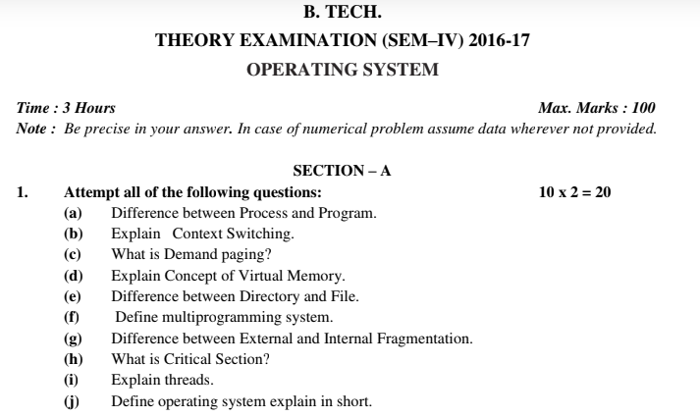
Old Question Papers

Slide 135
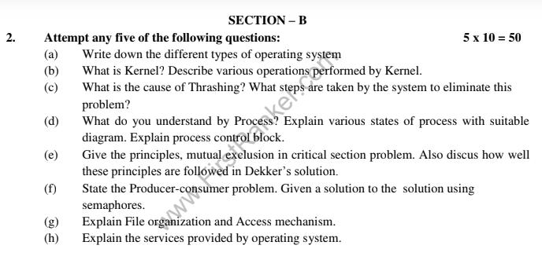
Old Question Papers
Operating System Concets

Slide 136
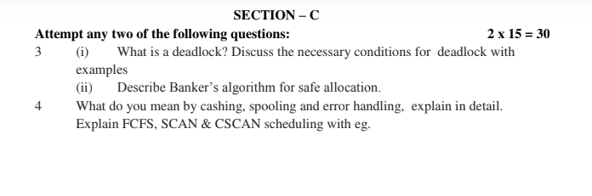
Old Question Papers
Operating System Concets

Slide 137
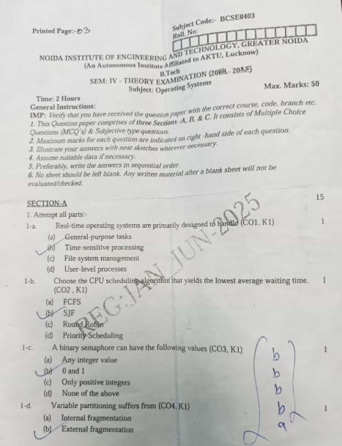
Old Question Papers
Operating System Concets

Slide 138
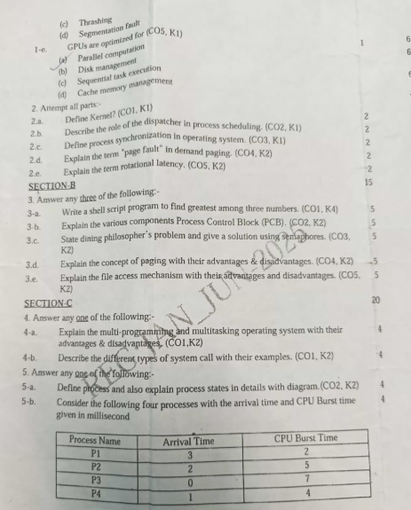
Old Question Papers
Operating System Concets

Slide 139
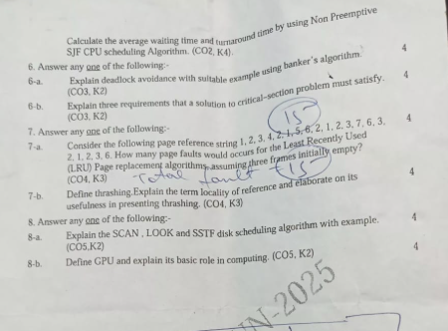
Old Question Papers
Operating System Concets

Slide 140
Expected Questions for University Exam
Define race condition.
Write and explain Peterson solution to the critical section problem.
Discuss product-consumer problem with semaphore.
Define critical section.
State the Readers/Writers problem with readers having higher priority. Give solution of the problem using semaphores.
Explain dinning philosopher problem & its solution.
Write a short note on inter-process communication with its advantages.
Define critical section.
Explain two primitive semaphore operations
Name some classic problem of synchronization
Operating System Concets

Slide 141
Expected Questions for University Exam
12. Write a note on Deadlock Prevention.
13. Write down the steps of Deadlock Detection
14. List out the necessary conditions for deadlock to occur.
Operating System Concets

Slide 142
Recap of Unit
In this module, we have studied the following:
Deadlocks
Deadlock Detection and Recovery
Cooperating process
Producer-Consumer Problem
Race condition
Critical Section
Peterson’s Solution
Classical Problems of Synchronization
Bounded-Buffer Problem
Readers and Writers Problem
Dining-Philosophers Problem
Problems with Semaphores
Inter-process Communication
Shared memory
Message passing
Operating System Concets

Slide 143
References
Books :
Silberschatz, Galvin and Gagne, “Operating Systems Concepts”, Wiley
SibsankarHalder and Alex A Aravind, “Operating Systems”, Pearson Education
Harvey M Dietel, “ An Introduction to Operating System”, Pearson Education
D M Dhamdhere, “Operating Systems : A Concept basedApproach”, McGraw Hill.
Charles Crowley, “Operating Systems: A Design-Oriented Approach”, Tata McGraw Hill Education”.
Stuart E. Madnick & John J. Donovan, “ Operating Systems”, Tata McGraw
Operating System Concets

